Slide 1
Final Slide Set 2

Slide 2
Move Semantics
CSCE 121
J. Michael Moore

Slide 3
Rvalues and Lvalues
Lvalues live beyond an expression
E.g. variables
Rvalues are temporary
E.g. x = 7 + 3
The 10 resulting from 7+3 is an Rvalue.

Slide 4
Inefficiency
vector<int> getReverse(const vector<int>& original) {
vector <int> reversed;
for (int i=original.size()-1; i >= 0; ++i) {
reversed.push_back(original.at(i));
}
return reversed;
}
Somewhere in main…
vector<int> k = {2, 4, 6, 8};
Vector<int> r = getReverse(k);

Slide 5
Before C++11
Vector is constructed in the function and returned in a temporary object.
The returned data is copied to the object getting the assignment.
Then the returned object is destructed.

Slide 6
After C++11
Instead of copying…
Pilfer / steal the dynamic parts from the temporary object and use in the object getting the assignment.
Instead of making a temporary copy then destructing the temporary,
Use what is already there and would be destructed anyway.
So if we had a vector with 1,000,000 elements…
instead of copying 1,000,000 elements (time consuming)
Point to those existing 1,000,000 elements and unpoint the temporary object.
Copying one pointer is much faster than copying 1,000,000 elements!

Slide 7
Move Constructor Declaration
MyClass(MyClass&& source);
&& indicates that it is an Rvalue, i.e. a temporary object.

Slide 8
Move Constructor Definition
MyClass::MyClass(MyClass&& source) {
// pilfer dynamic resources from source
// set dynamic resources to nullptr
}
More details here:
https://msdn.microsoft.com/en-us/library/dd293665.aspx

Slide 9
Move Assignment Declaration
MyClass& operator=(MyClass&& source);
&& indicates that it is an Rvalue, i.e. a temporary object.

Slide 10
Move Assignment Definition
This should look familiar!
Recall Copy Assignment.
MyClass& operator=(MyClass&& source) {
if (this != &source) {
// delete old data
// pilfer resources from source
// set pointers in source to nullptr
}
return *this;
}
More details here:
https://msdn.microsoft.com/en-us/library/dd293665.aspx

Slide 11
Recall
Copy Assignment
Copy Constructor
Move
Move
Check for self-assignment
Delete old data
Allocate new memory
Copy data from source
Allocate new memory
Copy data from source
Pilfer resources from source
Set pointers in source to nullptr
Pilfer resources from source
Set pointers in source to nullptr
Notes:
If we compare the copy assignment operator to the copy constructor, we see first of all that they take the same parameter: a const reference to the source object.
And it we look at what they do, we see that the copy constructor is the same as the copy assignment operator, minus a couple of missing steps that aren’t needed. Now why would we not need to check for self-assignment and delete old data?
... Because the object is just being created, so there’s nothing to delete yet, and it can’t be equal to the source because it’s not initialized yet.

Slide 12
Inheritance
CSCE 121
J. Michael Moore

Slide 13

Recall
Classes can model things that can be concrete or abstract.
Truck
Weight
Fuel type
Length
Height
Drive()
Stop()
Etc.

Slide 14
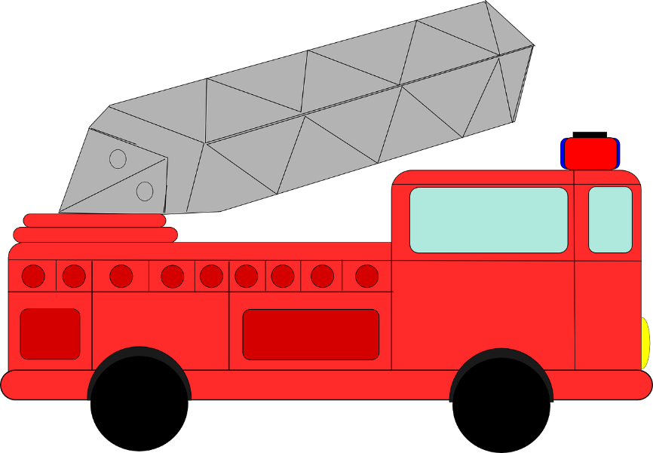
Fire Truck
Truck
Weight
Fuel type
Length
Height
Drive()
Stop()
WaterCapacity
startSiren()
stopSiren()
Add to truck class?

Slide 15


Concrete Truck
So we include members for all types of trucks?
Truck
Weight
Fuel type
Length
Height
Drive()
Stop()
WaterCapacity
startSiren()
stopSiren()
So every truck could “startSiren()”???
Add to truck class?
cubicFeetConcrete
Pour()

Slide 16



Separate Classes?
And more…
Truck
Weight
Fuel type
Length
Height
Drive()
Stop()
Fire Truck
Weight
Fuel type
Length
Height
Drive()
Stop()
WaterCapacity
startSiren()
stopSiren()
Concrete Truck
Weight
Fuel type
Length
Height
Drive()
Stop()
cubicFeetConcrete
Pour()

Slide 17
Separate Classes?
How many updates???
Truck
Weight
Fuel type
Length
Height
Width
Drive()
Stop()
Fire Truck
Weight
Fuel type
Length
Height
Drive()
Stop()
WaterCapacity
startSiren()
stopSiren()
Concrete Truck
Weight
Fuel type
Length
Height
Drive()
Stop()
cubicFeetConcrete
Pour()
Share what’s common?

Slide 18
Separate Classes!
Truck
Weight
Fuel type
Length
Height
Width
Drive()
Stop()
Share what’s common!
Fire Truck
WaterCapacity
startSiren()
stopSiren()
Concrete Truck
cubicFeetConcrete
Pour()

Slide 19
Inheritance
Truck
Weight
Fuel type
Length
Height
Width
Drive()
Stop()
Add to an existing class!
REUSE!!!
Fire Truck
WaterCapacity
startSiren()
stopSiren()
Concrete Truck
cubicFeetConcrete
Pour()
Truck AND Fire Truck
Truck AND Concrete Truck

Slide 20
Some Terminology
Base / Parent
Derived / Child / Sub-Class

Slide 21
Access Permissions
All code
Public
Private
Protected
Derived class’s members
Class’s own members
Public members
Protected members
Private members

Slide 22
UML Updates for Inheritance
Permissions
+ Public
- Private
# Protected

Slide 23
UML Updates for Inheritance
Relations
Association
Aggregation
Composition
Inheritance
Navigability concept of easy access from one to another
One
Many
Part of
Composite Object
Derived / Child
Base / Parent
Access from
Access to

Slide 24
Truck UML Class Diagram
Truck
-weight
-fuelType
-length
-height
-width
+drive()
+stop()
Fire Truck
Concrete Truck
-waterCapacity
-cubicFeetConcrete
+startSiren()
+stopSiren()
+pour()

Slide 25
Instance of a Fire Truck, i.e. Fire Truck Object
Truck
It is both a Truck AND a Fire Truck!
-weight
-fuelType
-length
-height
-width
+drive()
+stop()
Fire Truck
-waterCapacity
+startSiren()
+stopSiren()

Slide 26
Anatomy of Inheritance
CSCE 121
J. Michael Moore
Based on slides by Carlos Soto.

Slide 27
A base class
class MyClass {
private:
// data, usually
int importantNum;
public:
MyClass(); // constructor(s)
MyClass(int importantNum);
// interface functions
};

Slide 28
An inherited class
class MyInheritedClass: public MyClass {
private:
// data, usually
public:
MyInheritedClass(); // constructor(s)
// interface functions
};

Slide 29
Member access
Not accessible outside MyClass, not even in classes derived from MyClass
class MyClass {
private:
// data, usually
int importantNum;
public:
MyClass(); // constructor(s)
MyClass(int importantNum);
// interface functions
};
Notes:
If we look back at our base class, we see that it has private and public members, as we’ve seen before.
The problem is that even though classes derived from this one automatically CONTAIN all these members, they don’t necessarily have ACCESS to them. Private members of the base class cannot be accessed in derived classes.
Let’s see an example.

Slide 30
Member Access
class Automobile {
private:
int modelYear;
string make;
public:
// ...
};
class Hybrid: public Automobile {
private:
double batteryCap;
public:
// ...
}
Hybrid cannot access modelYear or make!

Slide 31
Member Access: protected
class Automobile {
private:
// ...
protected:
int modelYear;
string make;
public:
// ...
};
class Hybrid: public Automobile {
private:
double batteryCap;
public:
// ...
}
Hybrid CAN access modelYear and make!

Slide 32
Member access in Inherited Classes
Access Type | public | protected | private
Same class | yes | yes | yes
Derived classes | yes | yes | no
Outside classes | yes | no | no

Slide 33
Not everything gets inherited...
Constructors
Base class’s default constructor automatically called by constructors of derived classes
Best to call the one you want / need.
The function operator= (if it was overloaded in base class)

Slide 34
Constructors in Inherited Classes
class MyInheritedClass: public MyClass {
private:
// ...
public:
MyInheritedClass() {}
// ...
};
Implicit call to base class default constructor.

Slide 35
Constructors in Inherited Classes
class MyInheritedClass: public MyClass {
private:
// ...
public:
MyInheritedClass() : MyClass() {}
MyInheritedClass(int importantNum)
: MyClass(importantNum) {}
// ...
};
Explicit calls to base class constructor that match what is needed.

Slide 36
Calling parent constructor in initialization list
class Hybrid: public Automobile {
private:
double batteryCap;
public:
Hybrid(string make, int modelYear, double batteryCap) :
Automobile(make, modelYear), batteryCap(batteryCap) {}
};

Slide 37
Types of Inheritance (relative to derived class)
Public
Base class public members -> public here
Base class protected members -> protected here
Protected
Base class public and protected members -> protected here
Private
All base class members -> private here

Slide 38
How Inheritance Works with Memory Diagram
CSCE 121
J. Michael Moore

Slide 39
output
struct Person {
string name;
int weight;
};
struct Doctor : public Person {
string specialty;
};
int main() {
Person* p = new Person;
p->name = "George";
p->weight = 187;
Doctor* d = new Doctor;
d->name = "Sam";
d->weight = 165;
d->specialty = "surgeon";
Person* w;
w = d;
}
identifier
stack
heap

Slide 40
output
struct Person {
string name;
int weight;
};
struct Doctor : public Person {
string specialty;
};
int main() {
Person* p = new Person;
p->name = "George";
p->weight = 187;
Doctor* d = new Doctor;
d->name = "Sam";
d->weight = 165;
d->specialty = "surgeon";
Person* w;
w = d;
}
w
main
d
p
identifier
stack
heap

Slide 41
output
struct Person {
string name;
int weight;
};
struct Doctor : public Person {
string specialty;
};
int main() {
Person* p = new Person;
p->name = "George";
p->weight = 187;
Doctor* d = new Doctor;
d->name = "Sam";
d->weight = 165;
d->specialty = "surgeon";
Person* w;
w = d;
}
w
main
name
George
d
weight
187
p
identifier
stack
heap

Slide 42
output
struct Person {
string name;
int weight;
};
struct Doctor : public Person {
string specialty;
};
int main() {
Person* p = new Person;
p->name = "George";
p->weight = 187;
Doctor* d = new Doctor;
d->name = "Sam";
d->weight = 165;
d->specialty = "surgeon";
Person* w;
w = d;
}
name
Sam
weight
165
specialty
surgeon
w
main
name
George
d
weight
187
p
identifier
stack
heap

Slide 43
output
struct Person {
string name;
int weight;
};
struct Doctor : public Person {
string specialty;
};
int main() {
Person* p = new Person;
p->name = "George";
p->weight = 187;
Doctor* d = new Doctor;
d->name = "Sam";
d->weight = 165;
d->specialty = "surgeon";
Person* w;
w = d;
}
name
Sam
weight
165
specialty
surgeon
w
main
name
George
d
weight
187
p
identifier
stack
heap

Slide 44
output
struct Person {
string name;
int weight;
};
struct Doctor : public Person {
string specialty;
};
int main() {
Person* p = new Person;
p->name = "George";
p->weight = 187;
Doctor* d = new Doctor;
d->name = "Sam";
d->weight = 165;
d->specialty = "surgeon";
Person* w;
w = d;
}
w can only see members of Person.
Even though specialty is there, w cannot see it.
name
Sam
weight
165
specialty
surgeon
w
main
name
George
d
weight
187
p
identifier
stack
heap

Slide 45
output
struct Person {
string name;
int weight;
};
struct Doctor : public Person {
string specialty;
};
int main() {
Person* p = new Person;
p->name = "George";
p->weight = 187;
Doctor* d = new Doctor;
d->name = "Sam";
d->weight = 165;
d->specialty = "surgeon";
Person* w;
w = d;
}
Shading was for illustration, for an exam this is what you would draw.
name
Sam
weight
165
specialty
surgeon
w
main
name
George
d
weight
187
p
identifier
stack
heap

Slide 46
Polymorphism
CSCE 121
J. Michael Moore

Slide 47
Recall
When you create an instance of a derived class, it is both:
an instance of the base class
an instance of the derived class.
So all of the actions/attributes possible with the parent class are possible with the derived class.

Slide 48
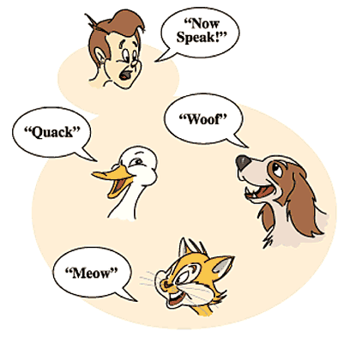
Speak!
Same command!
Results differ based on the type of animal.

Slide 49
Polymorphism Basic
A little Greek
What does poly mean?
What does morph mean?
So when the person says “Speak”, each animal (morph / shape) speaks according to what type of animal it is.
With polymorphism, we can indicate a method (e.g. speak) and regardless of the underlying type, it will do what is appropriate for that type (e.g. “quack”, “meow”, “woof”).

Slide 50
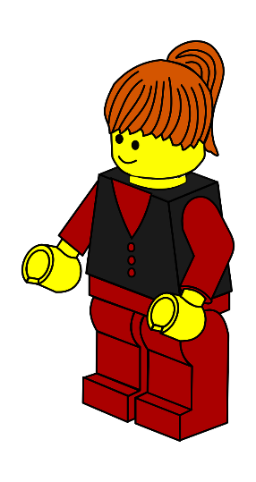



Person Example
Person (parent / base class)
Firefighter (child / derived class)
Doctor (child / derived class)
Chef (child / derived class)

Slide 51
C++
Can only see an object as one thing at a time.
E.g. can only treat an object as a person or as a firefighter depending on the current view (datatype… more in anatomy)
Suppose you create a method/attribute in a derived class that exactly matches something in the parent (note: this is allowed)
If looking through firefighter lens, the firefighter version is used.
If looking through person lens, the person version is used.

Slide 52
Simple Interface
We only need to know one method to use with an unknown number of sub-classes.
So, with polymorphism, we can use the person lens to look at people and we do not have to worry about what sub-class each one is.
However, not very useful if we can only do what the parent class does by default.

Slide 53
Polymorphism Useful
What if we want to use the sub-class version instead of the parent-class version?
E.g. the firefighter version instead of the person version
There needs to be a way to indicate that the sub-class version should override the parent version.

Slide 54
Virtual
Indicate in the parent that the child version should be used instead if parent version is also available.
In C++ this is known as a virtual function.
When looking at an instance of a base class, when it sees “virtual” it knows to use the derived class version of the function.
If the derived class does not have its own version, it will use the base class version.

Slide 55
Abstract
Suppose there is not a meaningful version to use in the base class?
Indicate that the method is abstract.
In C++ this is called a pure virtual function.
When looking at an instance of a base class, when it sees “pure virtual” it knows it looks for the derived version.
If the derived class does not have its own version, it will not compile.

Slide 56
Abstract Class
An abstract class cannot be instantiated!
In C++ this is accomplished by having at least one pure virtual function in the base class.
This makes sense.
If you have a pure virtual function, there is no default definition for that function, so it cannot be created.
Child classes that will be instantiated MUST define its version of the pure virtual function.

Slide 57
Guidelines
Want derived classes to have the option of overriding a function since a default is provided.
Make it a virtual
Want to force derived classes to override a function (i.e. do not provide a default)
Make it pure virtual

Slide 58
UML Update for Virtual
UML supports indicating polymorphism by indicating virtual functions.
Virtual functions are written in italics. If hand written, underline.
There is not a way to indicate pure virtual functions in standard UML.
On exams I will ask you to put “pv” before functions that should be pure virtual.

Slide 59
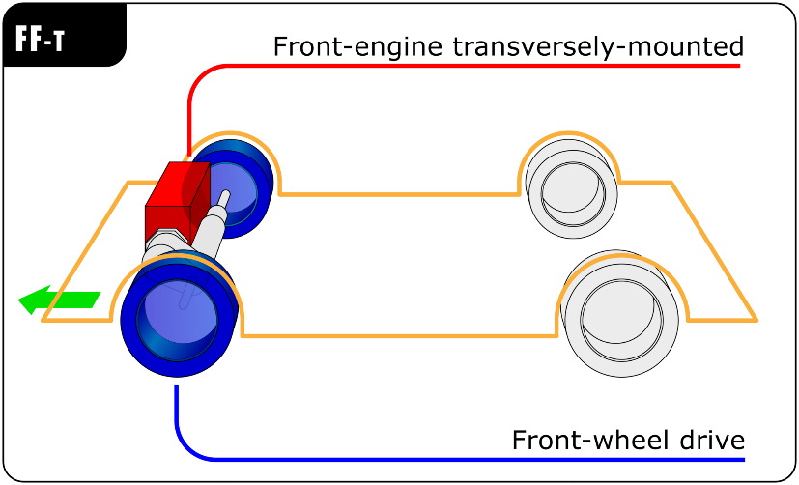
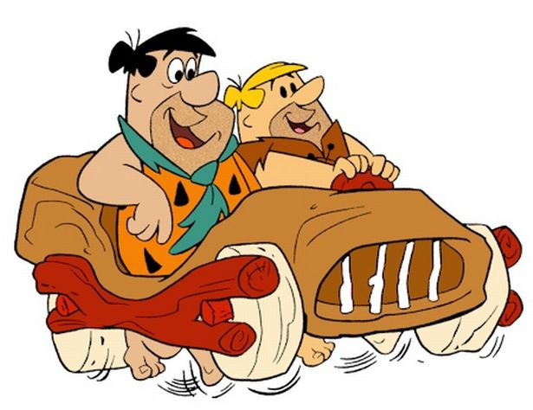
Different ways to drive.
Vehicle
-weight
-length
-height
-width
+drive()
+stop()
Flintstone
Front Wheel Drive
Virtual functions
+drive()
+stop()
+drive()
+stop()
Flintstone image taken from: http://www.dailyrecord.co.uk/news/local-news/yabba-dabba-shotts-man-puts-7654559#sDmfmSD8V1mpZXUH.97
FWD image: By Moebiusuibeom-en (Own work) [CC BY-SA 3.0 (http://creativecommons.org/licenses/by-sa/3.0) or GFDL (http://www.gnu.org/copyleft/fdl.html)], via Wikimedia Commons

Slide 60
Anatomy of Polymorphism
CSCE 121
J. Michael Moore
Based on slides created by Carlos Soto.

Slide 61
A motivating example
class Automobile {
// ...
public:
double getRange() {
// compute from gas
}
};
class Hybrid: public Automobile {
// ...
public:
double getRange() {
// compute from gas
// and battery
}
};

Slide 62
Function overriding
class Automobile {
// ...
public:
virtual double getRange() {
// compute from gas
}
};

Slide 63
Function overriding: virtual functions
class Automobile {
public:
virtual double getRange() {/*...*/}
};
class Hybrid: public Automobile {
public:
double getRange() {/*...*/}
};

Slide 64
Beware!
Do not confuse overloading with overriding!
Overloading
Overriding
The new function has a different signature!
What we already know!
The new function has the exact same signature!

Slide 65
Using overridden functions
Automobile myauto;
cout << myauto.getRange();
Hybrid myhybrid;
cout << myhybrid.getRange();
Calling the base class / default version.
Calling the overridden version. (Defined in derived class.)
Note: this is overriding since the function signatures are the same!

Slide 66
Pure virtual functions
Shape is an “abstract base class”
Because it has a “pure virtual function”
Objects of this type cannot be created / instantiated
class Shape {
// ...
public:
virtual double getArea() = 0;
};
Indicates a “pure virtual function”
For a derived class to be instantiated, this function MUST be defined.
Notes:
In the previous example, we defined getRange in the base class, and redefined it in the base class, by overriding it. But we can choose not to define a function at all in the base class, and only have it defined in derived classes.
We do this by making that function a PURE virtual function, and this has some important consequences.
First, any class that contains one or more pure virtual functions becomes an ABSTRACT class, which means you can no longer use it directly as an object type. And the pure virtual function MUST be implemented in every derived class that is not abstract too.

Slide 67
Function hiding
class Base {
// ...
public:
void foo(int a) {
// ...
}
};
class Child: public Base {
// ...
public:
void foo(int a) {
}
};
Not overriding.
Notice: No “virtual”
Hiding!
Avoid!!!

Slide 68
Function hiding (which you should avoid)
class Base {
// ...
public:
void foo(char c) {
// ...
}
};
class Child: public Base {
// ...
public:
void foo(int a) {
}
};
Note the signatures differ…
Still hiding!

Slide 69
Accessing Hidden Things
class Base {
// ...
public:
void foo(int a) {
// ...
}
};
class Child: public Base {
// ...
public:
void foo(int a) {
}
};
int main() {
Base b;
b.foo(7);
Child c;
c.foo(8);
c.Base::foo(8);
}
Base version.
Child version.
Base version.
Avoid!!!

Slide 70
Polymorphism
Allows a single function call to automatically call the version of that function for the correct class type
Even if you don’t know at compile-time what the type will be
Sometimes called dynamic/runtime polymorphism

